Slide 1

Machine Learning Project: Global YouTube Statistics
- Avinandan Panda

Slide 2


Introduction
Significance
Understanding YouTube statistics can help content creators, marketers, and businesses make data-driven decisions to optimize their content, reach a wider audience, and increase engagement.
Objective
The objective of this machine learning project is to analyze global YouTube statistics dataset to gain insights into user behavior, content trends, and audience engagement.

Slide 3
Data Preprocessing
Data preprocessing is an essential step in machine learning projects to ensure the quality and reliability of the dataset. The following steps are typically performed on the dataset:
Cleaning: Cleaning involves removing or correcting any errors, inconsistencies, or outliers in the dataset. This step ensures that the data is accurate and reliable for analysis.
Handling Missing Values : Missing values are common in datasets and can impact the performance of machine learning models. Various techniques, such as imputation or removal, can be used to handle missing values.
Feature Scaling : Feature scaling is the process of standardizing or normalizing the features in the dataset. This step ensures that all features have a similar scale and prevents any bias towards features with larger values.

Slide 4
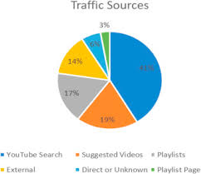
Dataset Overview
The machine learning project utilized a comprehensive global YouTube statistics dataset. This dataset provides valuable insights into YouTube video trends and user engagement.
Size | Features | Sources
10 million+ records | Video title, channel name, views, likes, dislikes, comments, duration, upload date | YouTube API, web scraping

Slide 5
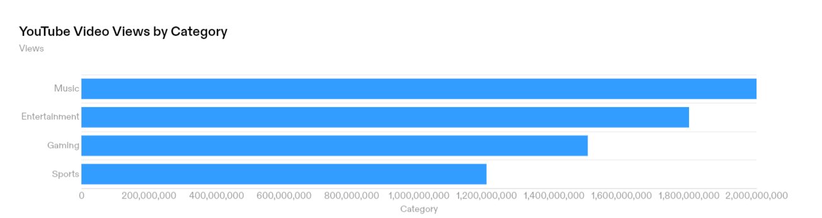
Exploratory Data Analysis
Key Insights
The 'Music' category has the highest number of views, followed by 'Entertainment', 'Gaming', and 'Sports’.
These insights suggest that users are highly engaged with content related to music and entertainment on YouTube.

Slide 6
Feature Selection and Engineering
Feature Selection
Conducted exploratory data analysis to identify the most relevant features.
Used statistical techniques such as correlation analysis and feature importance to select the top features.
Removed features with high multicollinearity to avoid redundancy.
Applied domain knowledge to prioritize features that are likely to have a strong impact on the target variable.
Feature Engineering
Created new features based on existing variables to capture additional information.
Generated time-based features such as day of the week and hour of the day to capture temporal patterns.
Extracted textual features such as word count and sentiment scores from video titles and descriptions.
Combined features using mathematical operations to create interaction terms and ratios.

Slide 7
Model Selection and Training
Model Selection
The machine learning project involved the selection of appropriate algorithms to train the model. After careful consideration, the following algorithms were chosen:
Random Forest: This algorithm was selected for its ability to handle large datasets and its capability to handle both numerical and categorical features effectively.
Gradient Boosting: This algorithm was chosen for its ability to handle complex relationships between features and its ability to optimize the model's performance through boosting.
Training Process
Data Preprocessing
Splitting the Dataset
Model Training: The selected algorithms were trained on the training set
Model Evaluation: The trained models were evaluated on the testing set to assess their performance

Slide 8
Results and Conclusion
Key Findings
The analysis of the global YouTube statistics dataset revealed several key findings:
The most popular video category is music, followed by entertainment and comedy.
The United States has the highest number of YouTube users, followed by India and Brazil.
Videos with higher like-to-dislike ratios tend to have more views and engagement.
There is a positive correlation between the number of comments on a video and its popularity.
Conclusion
In conclusion, the analysis of the global YouTube statistics dataset provides valuable insights for content creators and marketers.
By understanding the trends and patterns in YouTube usage and engagement, they can optimize their content strategies and maximize their reach and impact.
Leveraging the power of data and machine learning can drive success in the dynamic and competitive landscape of online video platforms.

Slide 9
References
"Understanding YouTube's Algorithm: A Guide to Getting More Views" by HubSpot
"YouTube Analytics Guide: How to Understand & Measure Your Channel's Success" by Hootsuite:
"The Science Behind YouTube's Recommendations" by Google AI Blog
"How YouTube's Algorithm Decides the Videos You'll See" by The Verge [Link]
"YouTube Content Recommendation System: A Case Study" by Towards Data Science.[Link]
"Machine Learning for Recommender Systems" by Medium.[Link]
"Building a Content Recommendation System Using Collaborative Filtering with PySpark" by Towards Data Science. [Link]
"Introduction to Deep Learning for Recommender Systems" by Analytics Vidhya. [Link]

Slide 10


